Slide 1
Secure Data Hiding in Images using Steganography
CAPSTONE PROJECT
Presented By: Nidhay Shukla
Student Name: Nidhay Shukla
College Name: S.B.E.S. College of Science.
Department: Computer Science & IT.

Slide 2
OUTLINE
Problem Statement
Technology used
Wow factor
End users
Result
Conclusion
Git-hub Link
Future scope

Slide 3
Problem Statement
Challenge:
Securely hide messages within images without altering their visual integrity.
Prevent message interception or unauthorized access. Ensure a simple yet effective encryption method without requiring advanced cryptographic knowledge.
Why It Matters?
Traditional encryption methods are often detectable.
Hidden messages within images provide an additional security layer.

Slide 4
Technology used
Python : Programming Language for Implementation.
OpenCV : Image Processing library for reading and modifying images.
Lossless PNG Format : Prevents compression artifacts for accurate message retrieval.

Slide 5
Wow factors
Invisible Encryption: Message is hidden inside pixel values without altering the image visibly.
No Extra Files Needed: The message is embedded directly into the image.
Simple & Lightweight: No need for heavy encryption algorithms—just pixel manipulation.
Custom Passcode: The decryption process requires a passcode for an additional layer of security.

Slide 6
End users
Journalists & Activists: Send confidential messages securely.
Cybersecurity Enthusiasts: Experiment with steganography techniques.
Educational Institutions: Teach students about cryptography and image processing.
Data Security Professionals: Use as a concept for secure data transmission.

Slide 7
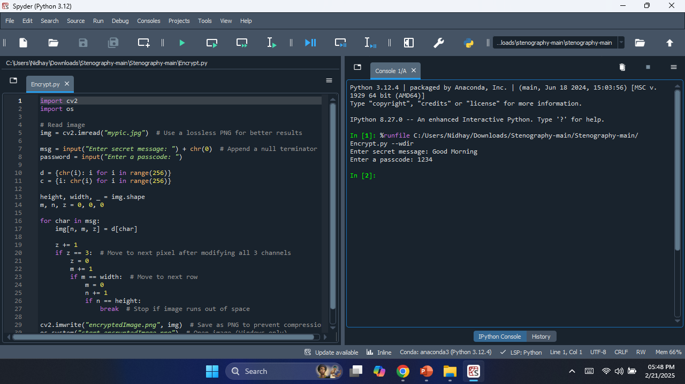
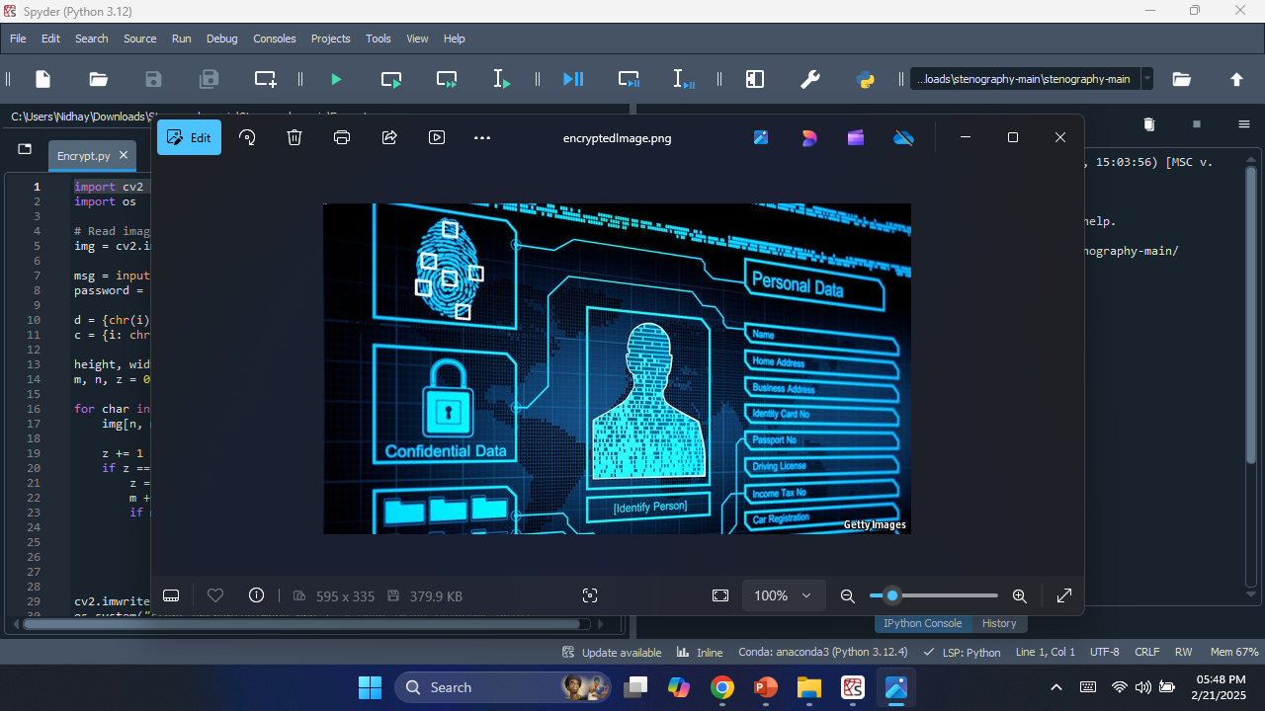
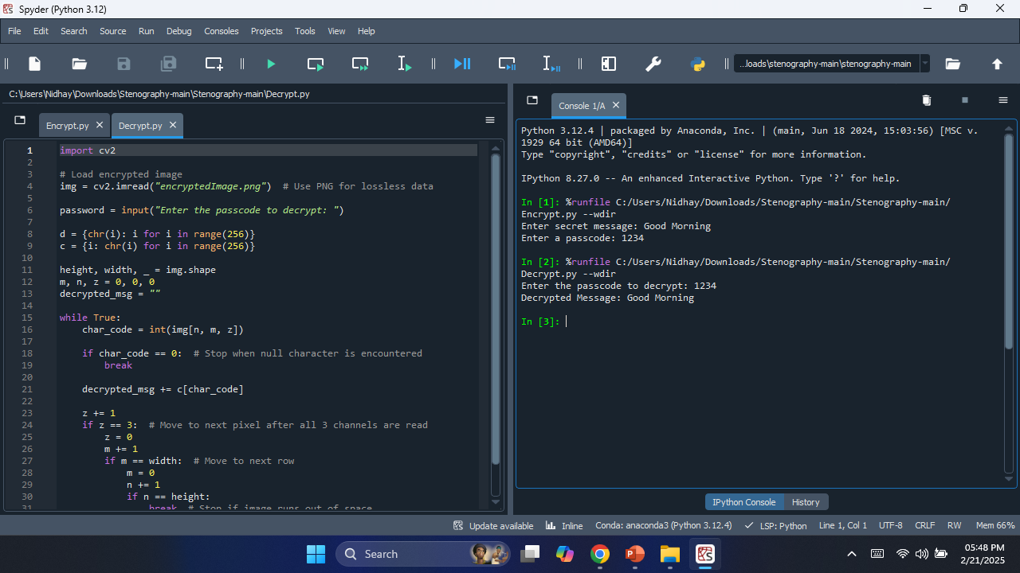
Results
Successfully encrypts and hides text inside an image.
The image remains visually unchanged.
Decryption extracts the original message accurately when the correct method is applied.
Using PNG format ensures no loss of data.

Slide 8
Conclusion
This project showcases a simple yet effective steganography technique.
It provides a secure and undetectable way of transmitting messages.
Suitable for educational, security, and research applications.
Can be further optimized for real-world use cases.

Slide 9
GitHub Link
GITHUB LINK :- https://github.com/nidhayshukla45/AICTE_project.git

Slide 10
Future scope(optional)
Advanced Steganography: Implement encryption within multiple layers of an image.
AI-Based Detection Prevention: Improve security by making hidden messages even harder to detect.
Mobile App Integration: Develop an Android/iOS app for quick encryption/decryption.
Higher Storage Capacity: Optimize pixel usage to store more data in smaller images.
Multiple File Formats: Extend support beyond PNG to GIF, BMP, and TIFF.

Slide 11
THANK YOU

